Slide 1
INVESTMENT ASSIGNMENT SUBMISSION
Name: Vinay Shivaram

Slide 2
Spark Funds Investment Case Study
Project Summary
Spark Funds want to take effective decisions and wants to know about the global trends in investments.
The CEO of Spark Funds wants to know about the latest trends in investments so she can make informed decisions.
Business Objective
Following are the two constraints for Spark Funds
It wants to invest between 5 to 15 million USD per round of investment
It wants to invest only in English-speaking countries for the ease of communication
Business Strategy
To identify the best sectors and countries to invest in for optimal returns.
Analyze to make investments with the strategy to invest where most other investors are investing.
Goals of Data Analysis
Investment type analysis
Country analysis
Sector Analysis ( distribution of investment understand across main sector)
Data Files Used
Companies.csv | Mapping.csv
Rounds2.csv | Countries_where_English_is_an_official_language.pdf

Slide 3
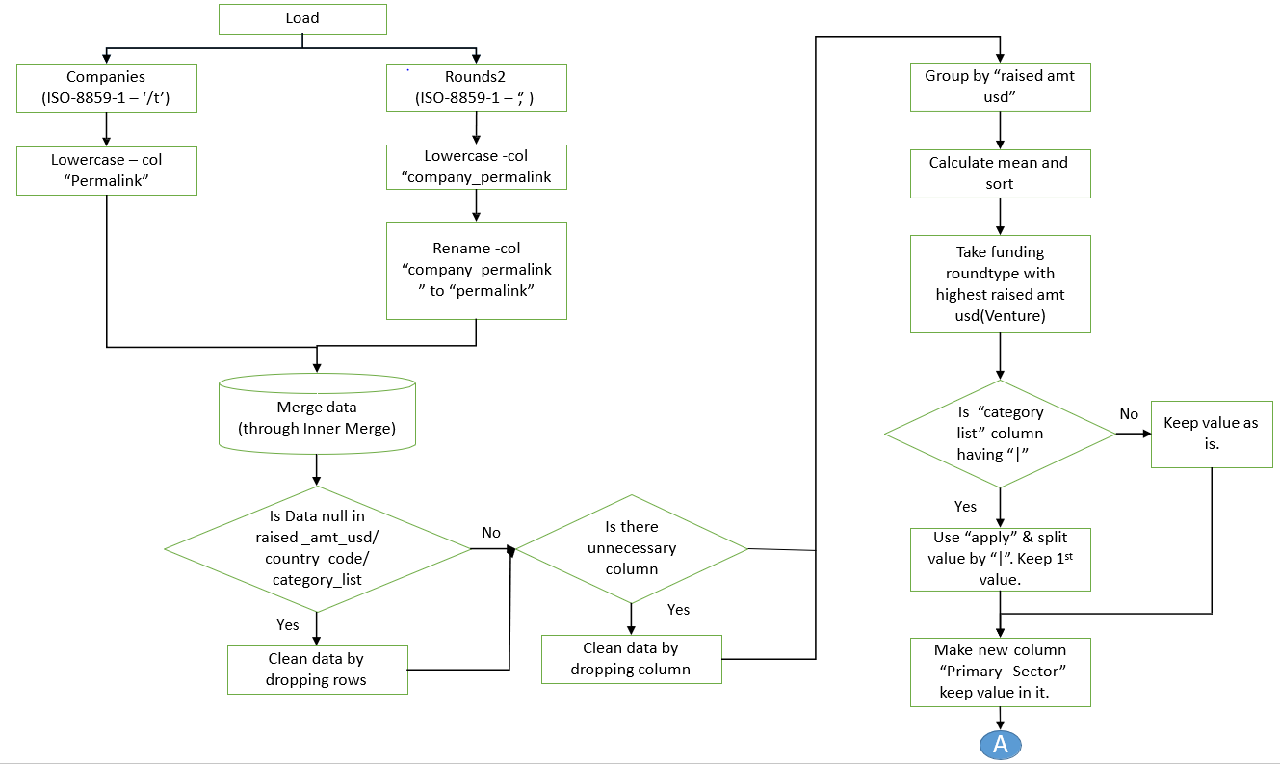
Flow Chart

Slide 4
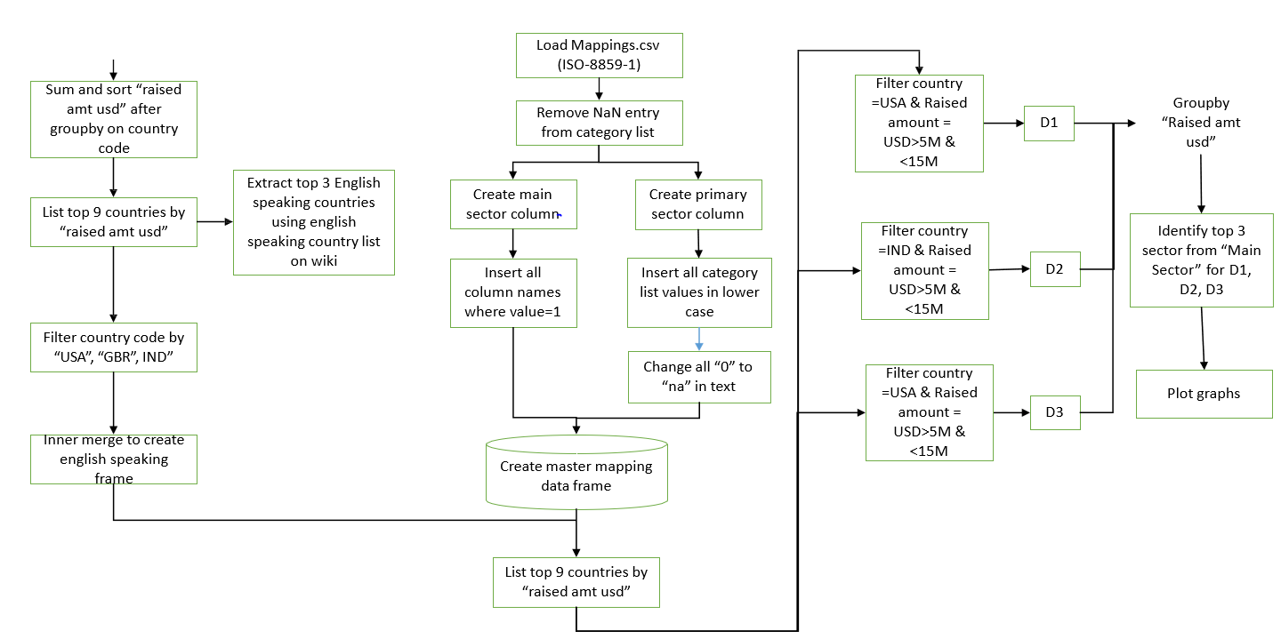
Flow Chart

Slide 5
Analysis – Understand the Data Set
Sl. No | Questions | Answer
1 | How many unique companies are present in rounds2? | 66370
2 | How many unique companies are present in the companies file? | 66368
3 | In the companies data frame, which column can be used as the unique key for each company? Write the name of the column. | permalink
4 | Are there any companies in the rounds2 file which are not present in companies ? Answer Y/N. | Y
5 | Merge the two data frames so that all variables (columns) in the companies frame are added to the rounds2 data frame. Name the merged frame master_frame. How many observations are present in master_frame ? | 114949

Slide 6
Analysis - Average Values of Investments for Each of these Funding Types
Average Values of Investments for Each of these Funding Types
Sl.No | Questions | Answer
1 | Average funding amount of venture type | 11748950
2 | Average funding amount of angel type | 958694
3 | Average funding amount of seed type | 719779
4 | Average funding amount of private equity type | 73308590
5 | Considering that Spark Funds wants to invest between 5 to 15 million USD per investment round, which investment type is the most suitable for them? | Venture

Slide 7
Analysis - Top 3 English-Speaking Countries
Analysing the Top 3 English-Speaking Countries
Sl.No | Questions | Answers
1 | Top English-speaking country | USA
2 | Second English speaking country | GBR
3 | Third English speaking country | IND

Slide 8
Analysis - Sector-wise Investment
Sector-wise Investment Analysis
Sl.no | Questions | C1 | C2 | C3
1 | Total number of Investments (count) | 12012 | 619 | 328
2 | Total amount of investment (USD) | 107318294664.00 | 5365228300 | 2949543602
3 | Top Sector name (no. of investment-wise) | Others | Others | Others
4 | Second Sector name (no. of investment-wise) | Social, Finance, Analytics, Advertising | Social, Finance, Analytics, Advertising | Social, Finance, Analytics, Advertising
5 | Third Sector name (no. of investment-wise) | Cleantech / Semiconductors | Cleantech / Semiconductors | News, Search and Messaging
6 | Number of investments in top sector (3) | 2950 | 147 | 110
7 | Number of investments in second sector (4) | 2714 | 133 | 60
8 | Number of investments in third sector (5) | 2300 | 128 | 52
9 | For point 3 (top sector count-wise), which company received the highest investment? | /organization/virtustream | /organization/electric-cloud | /organization/firstcry-com
10 | For point 4 (second best sector count-wise), which company received the highest investment? | /organization/shotspotter | /organization/celltick-technologies | /organization/manthan-systems

Slide 9
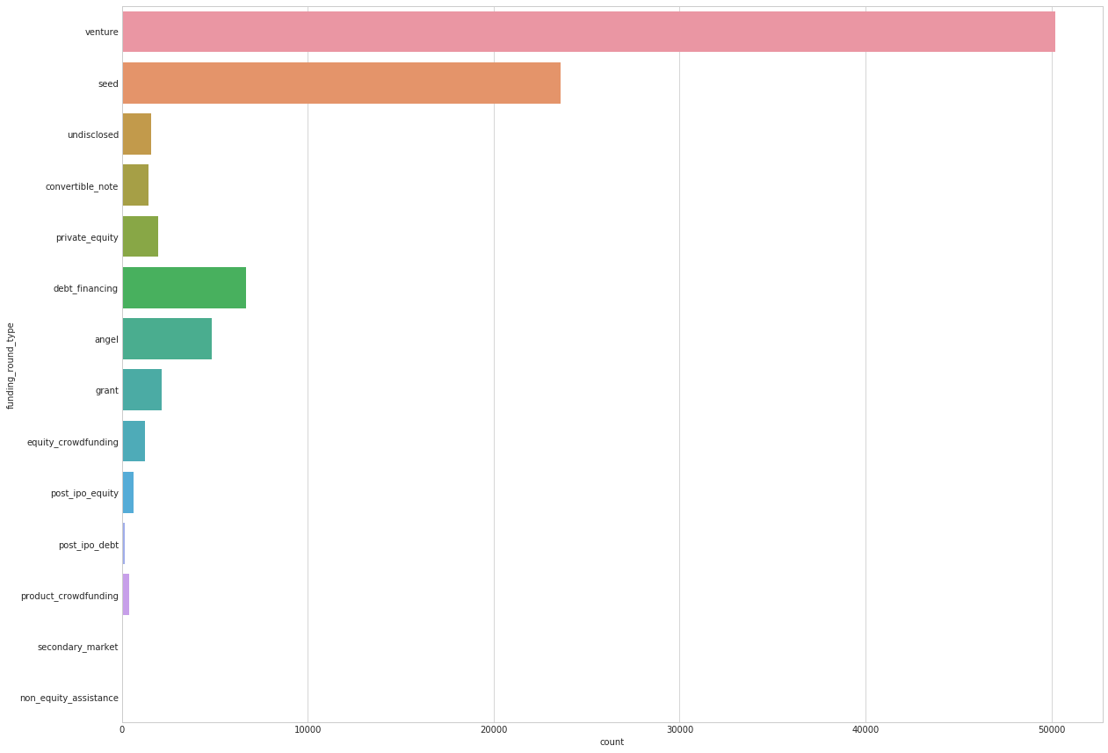
Result : Average Funding Type
Investment trend shows huge number of players investing in Venture funding

Slide 10
Average Amount of Investment in each Funding type and the fraction of total investments (globally) in Venture, Seed and Private Equity and Angel

Slide 11
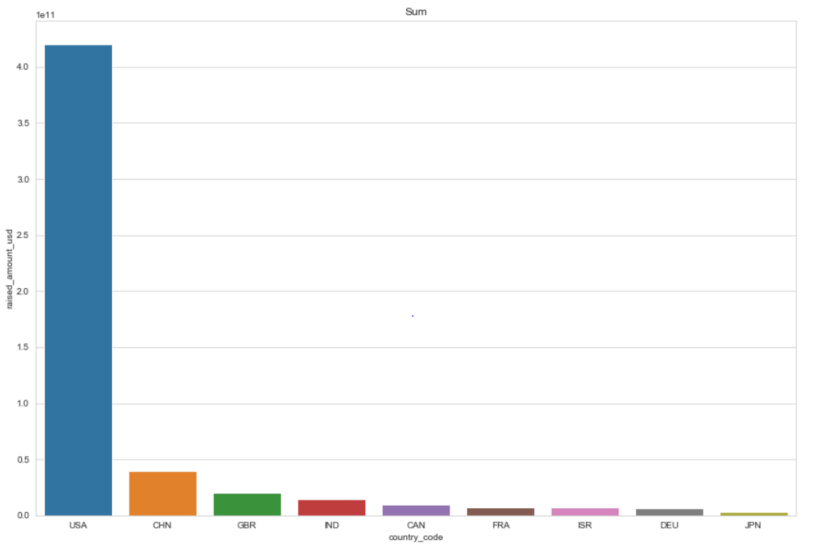
A plot showing the top 9 countries against the total amount of investments of funding type FT. This should make the top 3 countries (Country 1, Country 2, and Country 3) very clear.

Slide 12
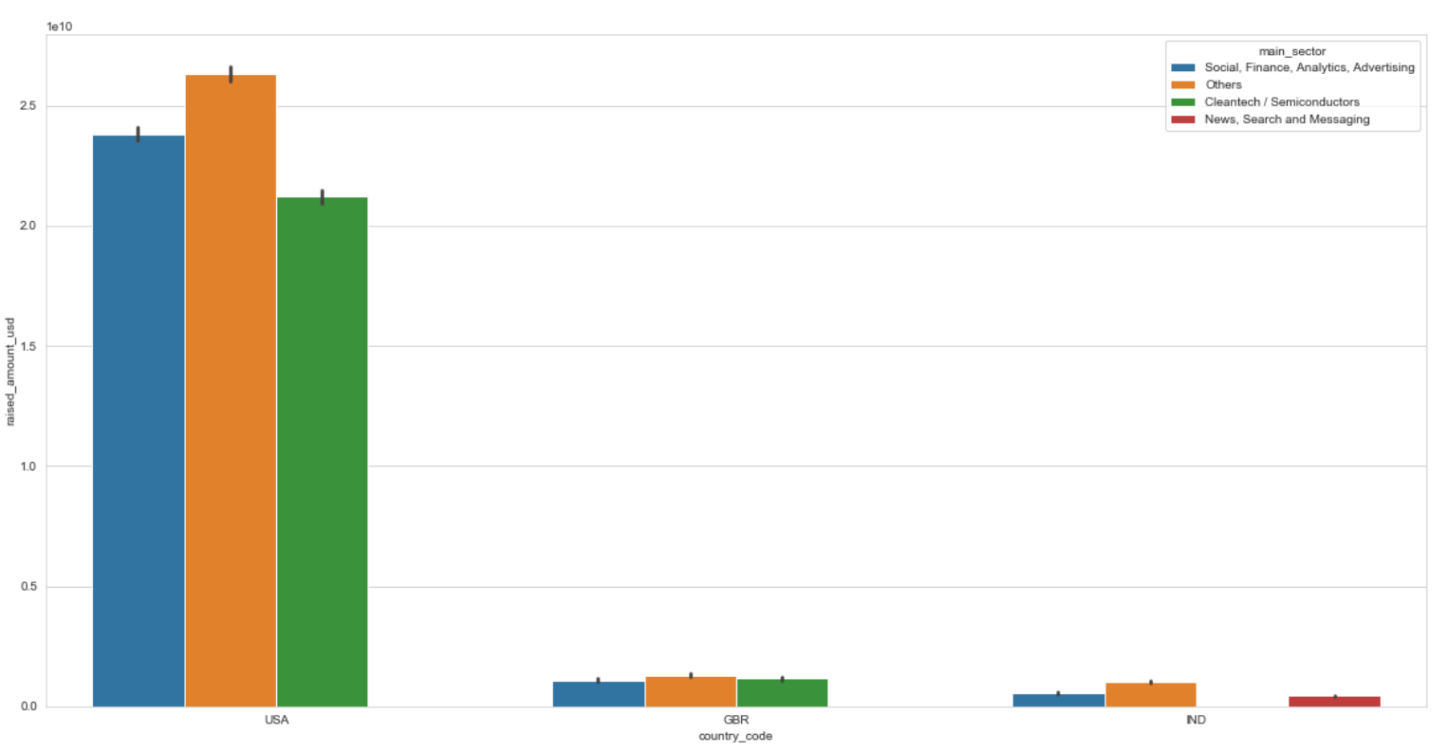
A plot showing the number of investments in the top 3 sectors of the top 3 countries on one chart.

Slide 13
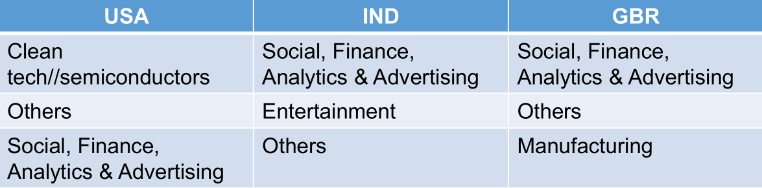
Conclusions
Based on the analysis, Spark Fund consider investing in the following countries.
Funding type: Private Equity
For English speaking countries: USA, IND, GBR

